Slide 1
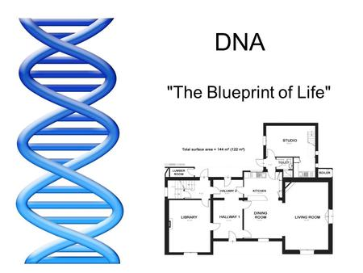

Slide 2
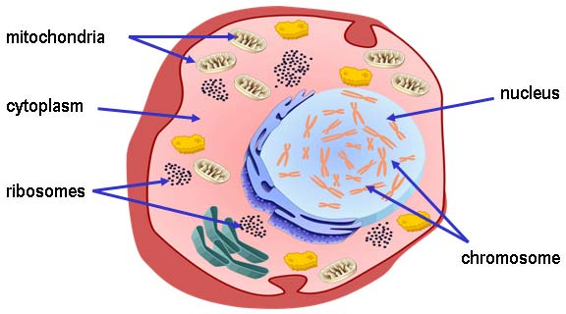

Slide 3
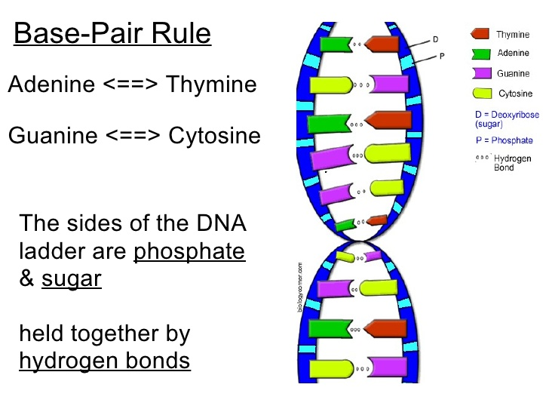

Slide 4
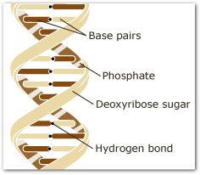

Slide 5

Chromosomes
Chromosomes are long, thin threadlike structures found in the nucleus of cells.
Chromosomes are made of DNA and protein.
Each cell in the human body contains 46 chromosomes (23 pairs).
1 pair of chromosomes determines gender (XX = Female, XY = Male)
Egg and Sperms cells are an exception, they only contain 23 chromosomes as they combine to make 46.

Slide 6
The function of DNA Genes
A chromosome consists of segments of DNA known as genes
Genes contain the instructions for the construction of a particular protein.
It is estimated that there are about 20,000–25,000 genes in the human genome (i.e. about 3 billion base pairs).
Different types of the same gene are known as alleles. Alleles govern characteristics such as hair colour.

Slide 7
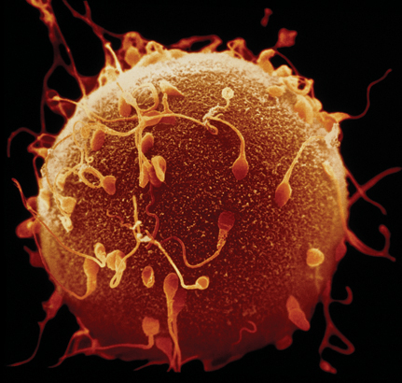
KEY CONCEPT
Genes encode proteins that produce a diverse range of traits.

Slide 8
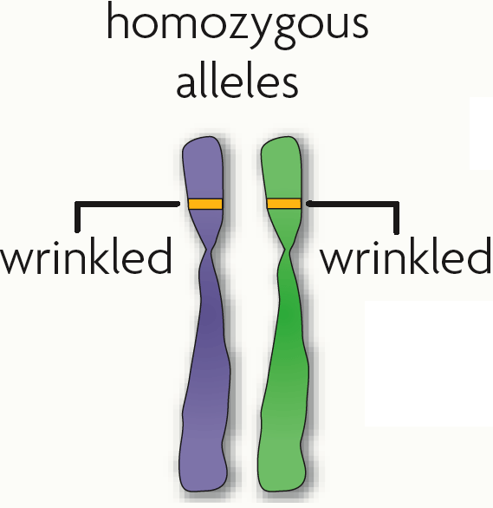
The same gene can have many versions called alleles.
A gene is a piece of DNA that directs a cell to make a certain protein.

Slide 9
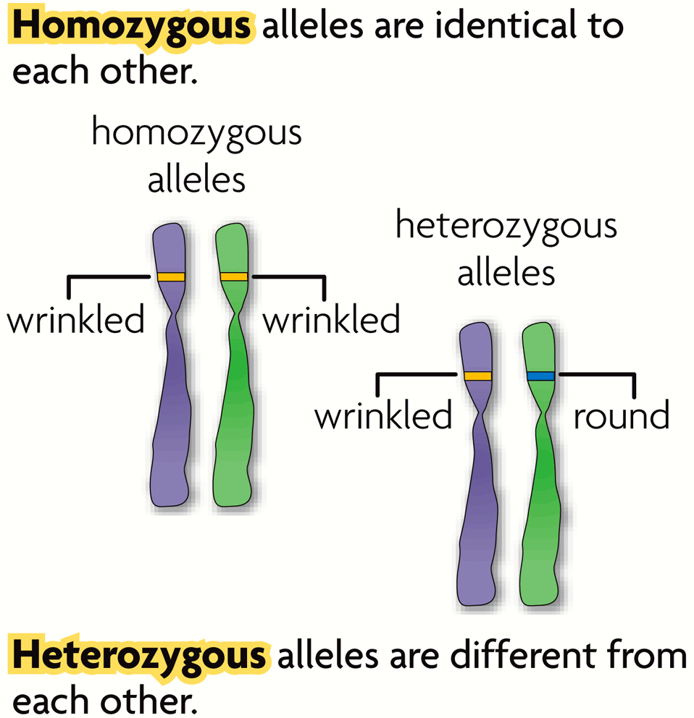
An allele is any alternative form of a gene occurring at a specific locus on a chromosome. Alleles are often represented by letters.
  Each parent donates one allele for every gene.
  Homozygous describes two alleles that are the same at a specific locus.
  Heterozygous describes two alleles that are different at a specific locus.
RR
Rr

Slide 10
An allele is any alternative form of a gene occurring at a specific locus on a chromosome. Alleles are often represented by letters.
GENE = eye colour
    hair colour
    ALLELE = blue or brown
    blonde or brown
RR
Rr

Slide 11
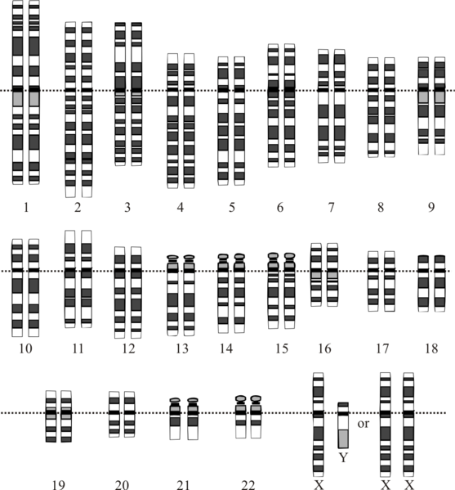
Genes influence the development of traits.
All of an organism’s genetic material is called the genome.
A genotype refers to the makeup of a specific set of genes. Examples: Bb, bb, BB
A phenotype is the physical expression or appearance of a trait. Examples: tall, round, blue

Slide 12
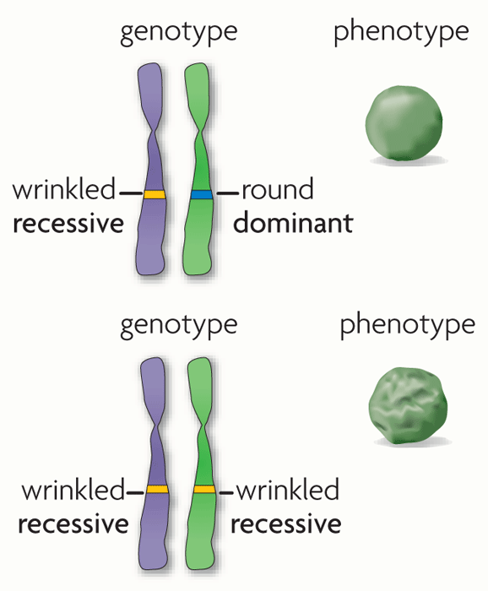
Alleles are often represented using letters.
  A dominant allele = expressed as a phenotype
  A recessive allele = masked by dominant. Only expressed as a phenotype only when two copies are present.

Slide 13
Location of DNA
Most of the DNA occurs in the cell nucleus; however, each mitochondrion contains 37 genes – this is referred to as mitochondrial DNA

Slide 14
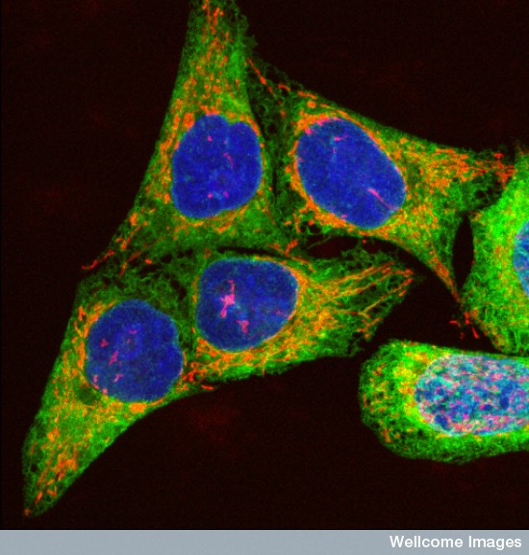
Human cells stained to show the DNA within the nuclei (blue), and the mitochondia in red.
Wellcome Images – Paul J Smith & Rachel Errington

Slide 15
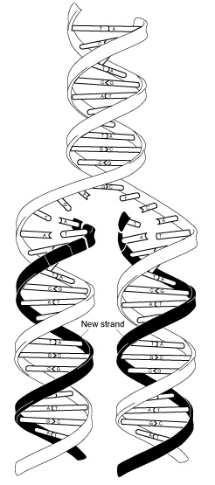
Replication
Old strand
New strand
NIH - National Human Genome Research Institute

Slide 16
DNA replication
DNA has the unusual property of being able to produce an exact copy of itself – this process is called DNA replication
This occurs before cell division.

Slide 17
An enzyme (Helicase) unzips the DNA molecule exposing the nitrogen base code.
Each exposed strand acts as a pattern or template for the construction of a new DNA molecule
DNA polymerase works its way along the template strand, and adds new nucleotides; A to T and G to C.

Slide 18
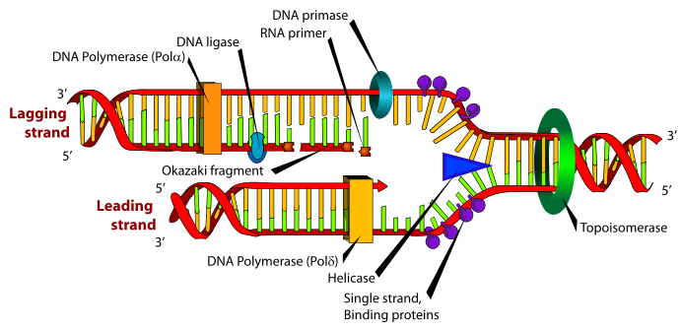
By LadyofHats

Slide 19

https://www.youtube.com/watch?v=Qqe4thU-os8

